Slide 1
Project NYSE DATA ANALYSIS

Slide 2
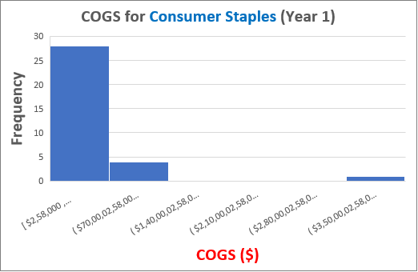
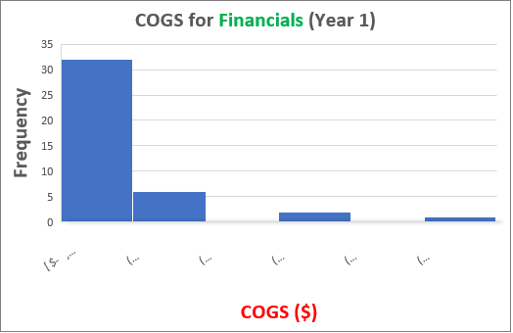
How does the Cost of Goods Sold (COGS) of Consumer Staples industry compare with that of the Financials Industry
Histograms of COGS of Consumer Staples and Financials Industries for year 1.
KEY INSIGHT : Right skewed histograms show that both the industries have their mean values more than median.
Description : The average Cost of Goods Sold (COGS) in consumer staples industry ($31 bn) is 4 times that of the financials industry ($7 bn) . As the sample size of consumer staples industry(33) is 3/4th of the financials industry(41), and standard error($11 bn) is more than 5 times, we can see that the standard deviation played a bigger role in error than the sample size. The standard deviation of Consumer staples industry($64 bn) is also 5 times that of financials industry($13 bn) showing a higher degree of variability in data of consumer staples industry.

